Slide 1
CosmoNav: AI-Powered Navigation for the Visually Impaired
Abinash Patti, Gursimar Singh, Vishnu Ajit

Slide 2

Bringing Space-Age Navigation Down to Earth
1
1957
Launched Sputnik and began mapping the stars
2
1978
First GPS satellite launched, mapping the entire globe
3
2025
Billions carry real-time maps in their pockets
The Final Frontier of Navigation
The Gap
Our Solution
We can navigate between cities and countries with pinpoint accuracy, yet we've failed to solve navigation for the final 10 steps. For 43,000,000 visually impaired people, everyday obstacles like staircases, puddles, and crosswalks remain unmapped hazards that threaten independence and safety.
CosmoNav bridges this critical gap with an intelligent app providing real-time navigation, voice-first interface, hazard detection via custom instance segmentation, and an AI assistant—empowering visually impaired individuals to navigate their world with confidence.

Slide 3
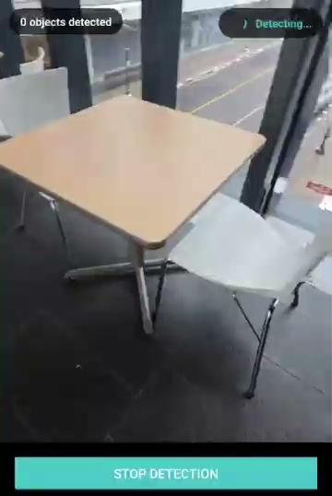
The Challenge We're Solving
43 Million People
Limited Solutions
Globally live with visual impairments, facing daily navigation challenges that limit independence and opportunity.
Traditional aids like white canes and guide dogs can't detect overhead hazards, read traffic signals, or provide route guidance.
Technology Gap
Existing GPS apps weren't designed for pedestrian micro-navigation or real-time hazard awareness—leaving a critical accessibility void.
CosmoNav represents a fundamental shift in assistive technology, transforming smartphones into intelligent navigation companions that understand and respond to the unique needs of visually impaired users.

Slide 4
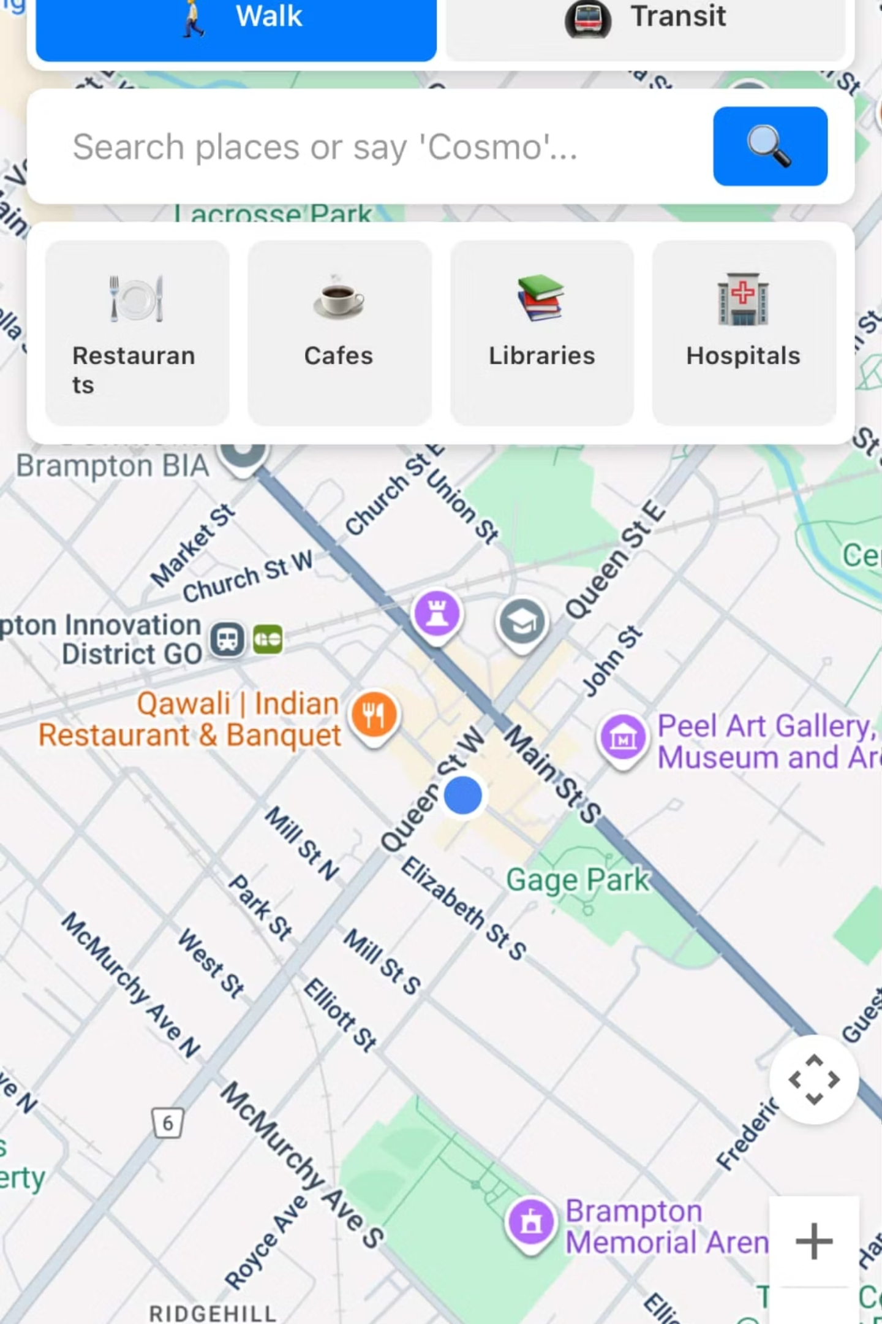




Intelligent Navigation Features
Voice-First Interface
Natural speech controls for destinations, weather queries, and AI conversation—completely hands-free navigation
Multi-Modal Routes
Seamless support for walking and public transit with intelligent voice mode switching throughout your journey
Computer Vision AI
Phone camera detects obstacles and hazards in real-time using custom instance segmentation models
Proactive Warnings
Early alerts for crosswalks, traffic lights, construction zones, and railway crossings keep users safe and informed

Slide 5
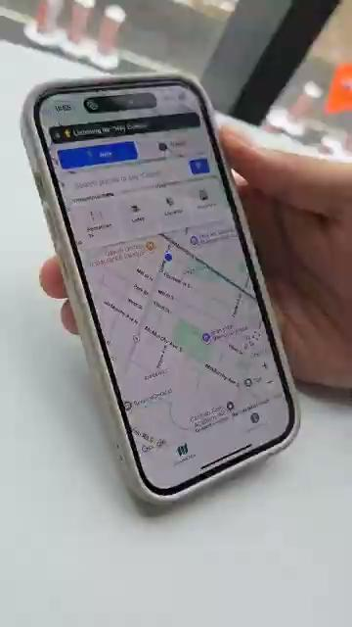

Slide 6
Built for Real-World Impact
User-Centered Design
Accessible Technology
Independence Amplified
Every feature emerged from understanding the daily realities of navigating without sight—from busy intersections to unpredictable weather conditions.
Leveraging existing smartphone hardware makes CosmoNav affordable and immediately available to millions who already own compatible devices.
More than navigation—CosmoNav restores confidence and expands possibilities for visually impaired individuals to explore their world freely.

Slide 7




Our Roadmap Forward
Enhanced AI Detection
Acquire additional compute power to train our segmentation model on massive, diverse datasets—dramatically improving accuracy across varied environments and lighting conditions.
Seamless Voice Experience
Refine speech-to-text capabilities to ensure flawless understanding in noisy urban environments, diverse accents, and rapid conversational exchanges.
Hardware Partnership
Collaborate with smart eyewear manufacturers to create an integrated, phone-free experience—keeping users' hands available and eyes forward.
Community Validation
Partner with institutions like the Canadian National Institute for the Blind (CNIB) to gather feedback from future users and ensure CosmoNav truly serves their needs.

Slide 8
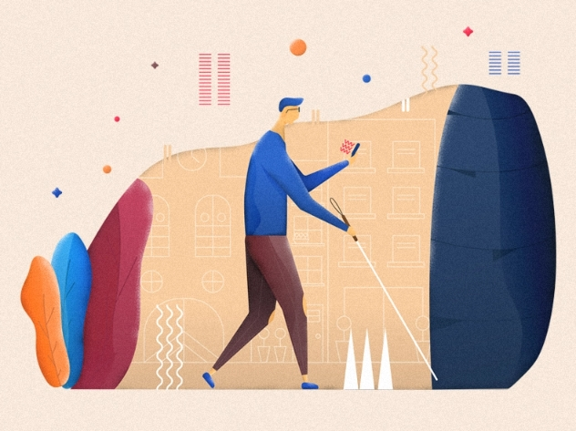
Join us in mapping the final frontier—transforming how visually impaired individuals experience the world around them.

